Slide 1
Software & Data Engineering Project Report
By Ravi Shankar Kumar & Debonil Ghosh
IIT Jodhpur

Slide 2
Problem Statement : How to Skip the commits for CI-CD which are not worth running hours of pipeline for it?
Problem Domain :
Software Engineering

Slide 3
The
Solution
A Machine Learning Approach to Improve the Detection of CI Skip Commits

Slide 4
Work Done!
Identifying the right Github project as Data source
Data Retrieval
Data Cleaning & Extraction
Preparing & normalizing Data
Related to Data Source & Pre-processing

Slide 5
Work Done (Cont..)!
Feature Engineering
Building the ML model
Model training & testing
Validation of Model
Performance Reporting
Related to Machine Learning Model

Slide 6
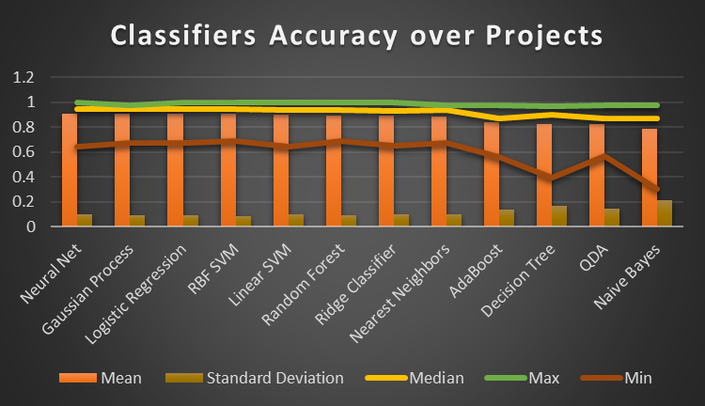

Slide 7
Conclusion: Neural Net has best accuracy among all classifiers, but Random Forest Classifier has explainability of the model with comparable performance with Neural Net

Slide 8
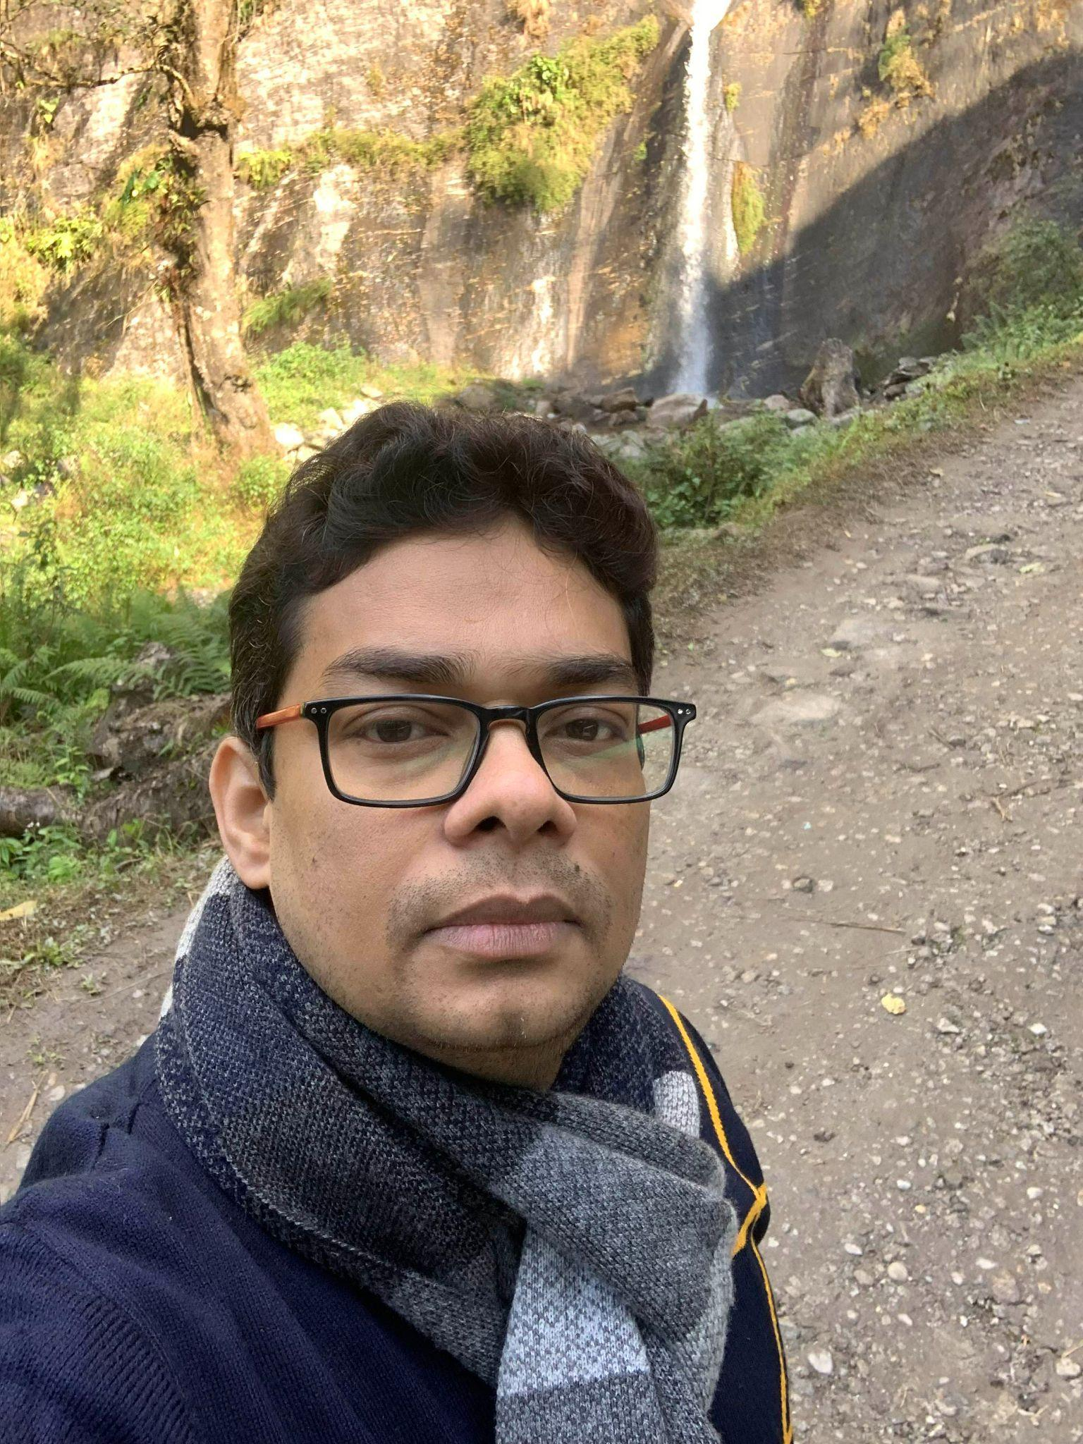
Ravi Shankar Kumar
Profession - IT & Softwares
Current Company - EPAM System India Pvt Ltd.
Title : Quality Architect -I
Educational Background - B.Tech in Computer Science from IIIT Kolkata & Pursuing M.Tech in AI & Machine learning from IIT Jodhpur
Total Experience - 15 years
Project Member

Slide 9
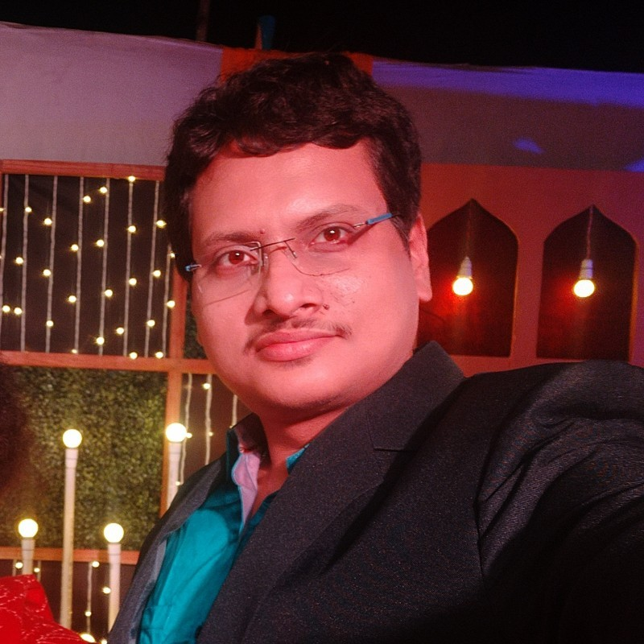
Debonil Ghosh
Profession - IT & Softwares
Current Company - Centre for Railway Information Systems (CRIS)
Title - Senior Software Engineer.
Educational Background - B.Tech in Computer Science from Govt College of Engineering and Textile Technology, Serampore & Pursuing M.Tech in AI & Machine learning from IIT Jodhpur
Total Experience - 8 years
Project Member

Slide 10

Team Members Contribution
.
Team Member-1 | Ravi Shankar Kumar | Coded Feature Extraction Code Feature engineering Coded ML model results calculation Worked on Report & PPT
Team Member-2 | Debonil Ghosh | Coded the Data Extraction Coded Data cleaning Coded ML models evaluation and Result Logging Worked on Report & PPT

Slide 11

Thank you!
We thank you our respected professor Sumit Kalra for helping us learn the subject well and also challenging us to do the project which was great learning and we learned multiple things. With that said would like to thank Teaching Assistants for their hard work by helping professor to smoothly conduct this course. Thank you Again!

